Slide 1
Linear Algebra

Slide 2
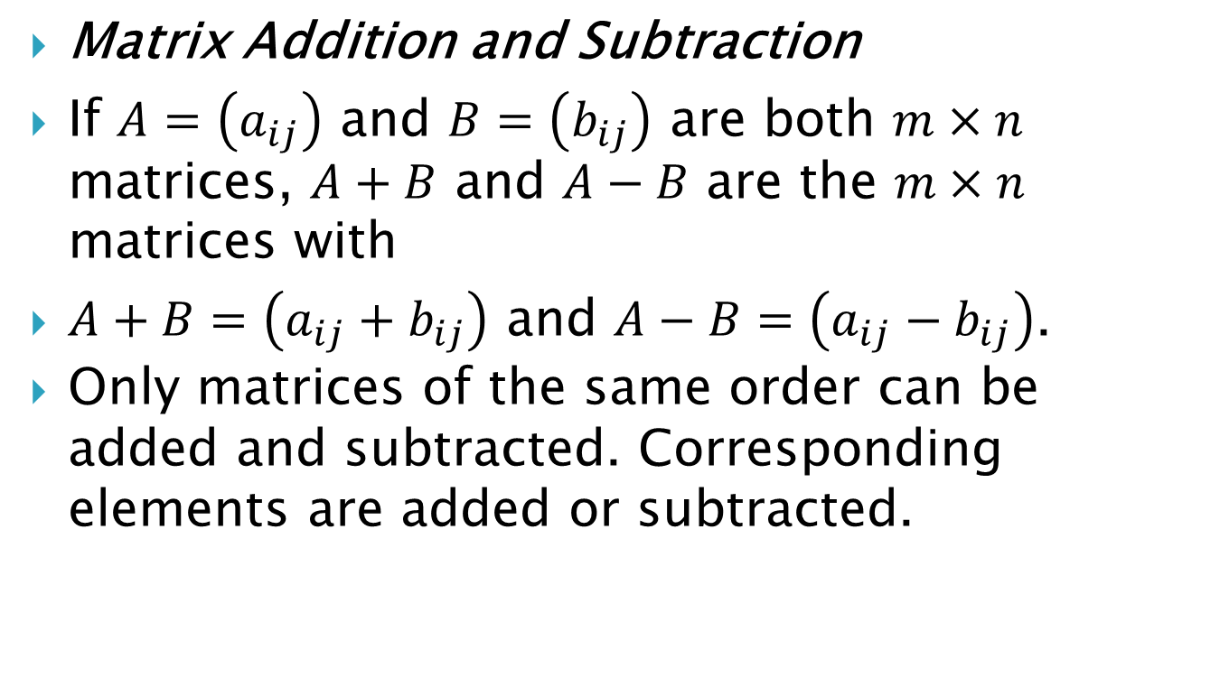
Operations on Matrices
Matrix Addition and Subtraction
If $A=\left(a_{ij}\right)$ and $B=\left(b_{ij}\right)$ are both $m×n$ matrices, $A+B$ and $A−B$ are the $m×n$ matrices with
$A+B=\left(a_{ij}+b_{ij}\right)$ and $A−B=\left(a_{ij}−b_{ij}\right)$.
Only matrices of the same order can be added and subtracted. Corresponding elements are added or subtracted.

Slide 3
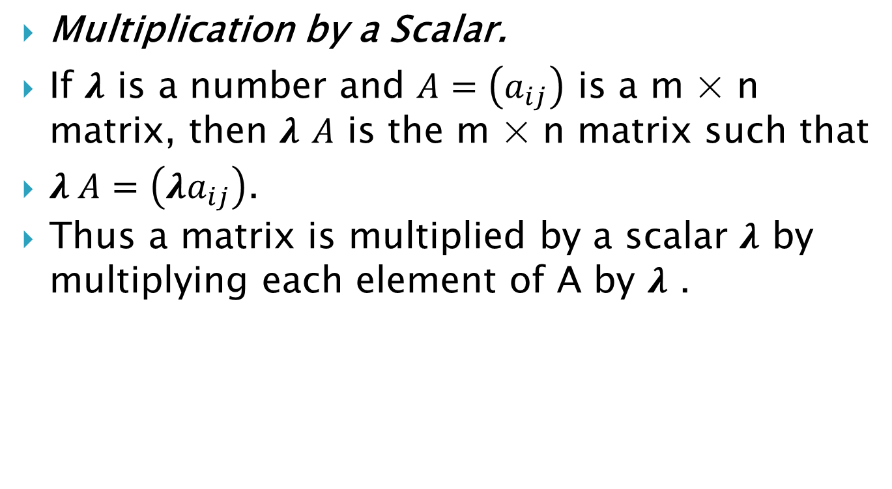
Multiplication by a Scalar.
If $λ$ is a number and $A=\left(a_{ij}\right)$ is a m × n matrix, then $λ$ $A$ is the m × n matrix such that
$λ A=\left({λa}_{ij}\right)$.
Thus a matrix is multiplied by a scalar $λ$ by multiplying each element of A by $λ$ .

Slide 4

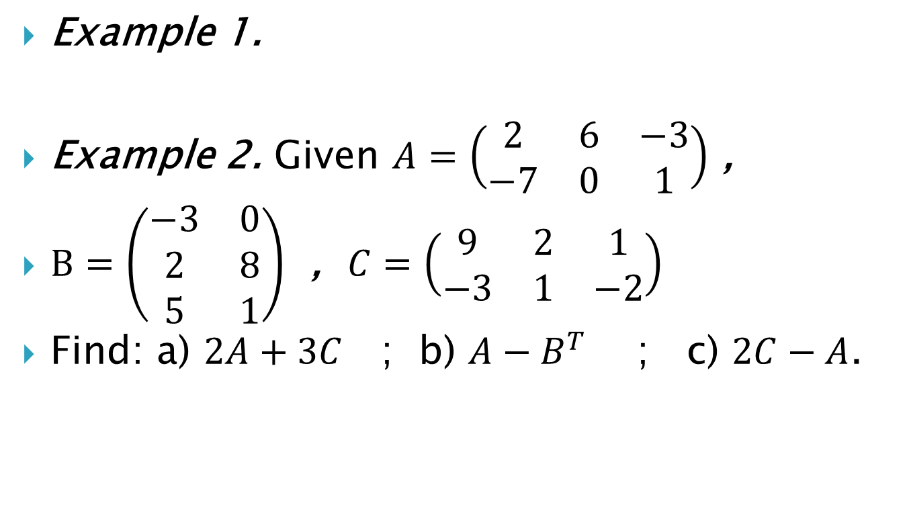
Example 1.
Example 2. Given $A=\left(\begin{matrix}2 & 6 & −3 \\ −7 & 0 & 1\end{matrix}\right)$ ,
$B=\left(\begin{matrix}−3 & 0 \\ 2 & 8 \\ 5 & 1\end{matrix}\right)$ , $C=\left(\begin{matrix}9 & 2 & 1 \\ −3 & 1 & −2\end{matrix}\right)$
Find: a) $2A+3C$ ; b) $A−B^{T}$ ; c) $2C−A$.

Slide 5
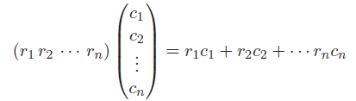
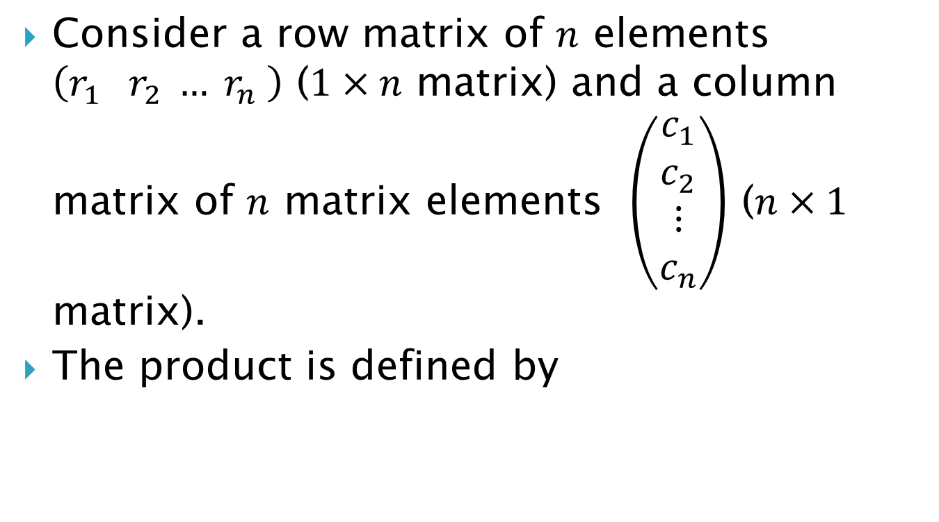
Matrix Multiplication
Consider a row matrix of $n$ elements $\left(r_{1} r_{2} … r_{n} \right)$ ($1×n$ matrix) and a column matrix of $n$ matrix elements $\left(\begin{matrix}c_{1} \\ c_{2} \\ ⋮ \\ c_{n}\end{matrix}\right)$ ($n×1$ matrix).
The product is defined by

Slide 6

Example 3. Find the product

Slide 7
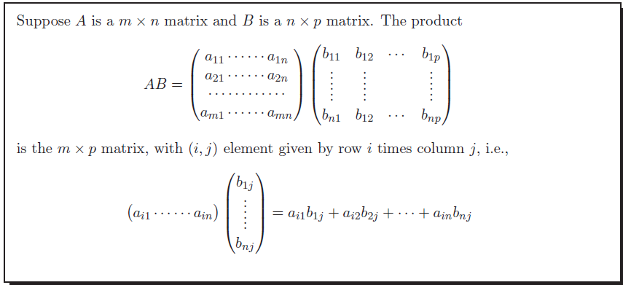
The general formula for the product AB is given as follows:

Slide 8




Example 4. Find and
Example 5.Find and

